Slide 1




MEE305 - HEAT TRANSFER
COURSE DESCRIPTION AND INFORMATION
Presented By Gürşah GÜRÜF

Slide 2
OVERVIEW
  Course Details
  Resources
  Objectives of the Course
  Assessment Methods
  Course Content
  Weekly Detailed Course Contents
  Course Methods
  Course Learning Outcomes
Presented By Gürşah GÜRÜF

Slide 3
COURSE DETAILS
Course Unit Code: MEE305
Course Unit Title: Heat Transfer
Semester: 5
T+P+L: 4+0+0
Credit: 4
Number of ECTS Credits: 4
Department / Program: Mechanical Engineering
Type of Program: Formal Education
Type of Course Unit: Compulsory
Course Delivery Method: Face To Face
Presented By Gürşah GÜRÜF

Slide 4
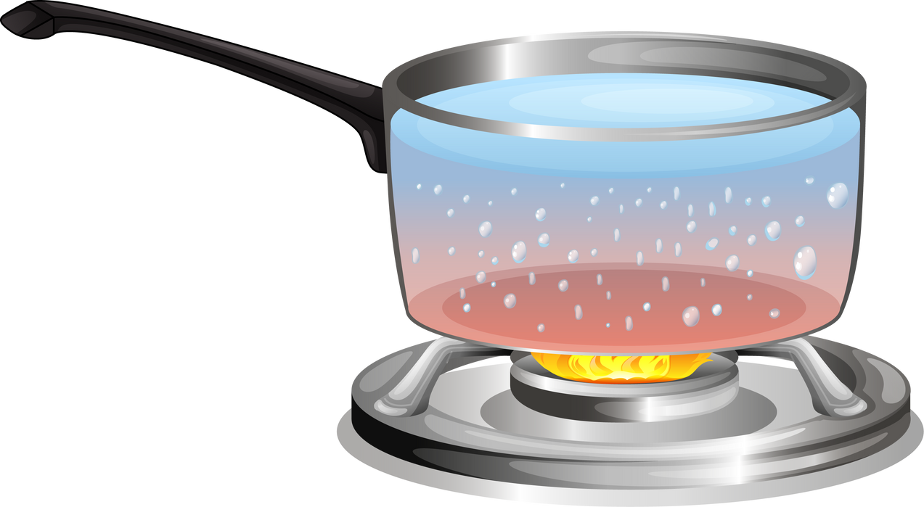
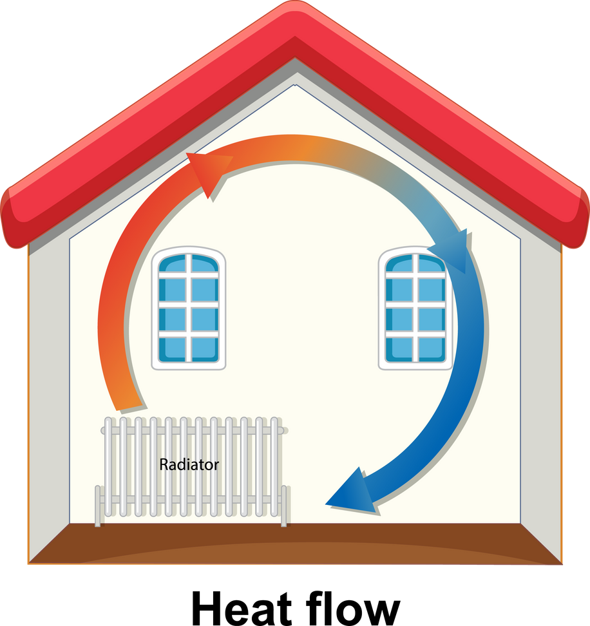

OBJECTIVES OF THE COURSE
This course aims to teach students the fundamentals of heat transfer by conduction, convection and radiation and to teach students the methods of deriving the basic equations in differential form for heat transfer problems using analytical techniques, property tables and related graphs and to help them develop solutions in this context.
Presented By Gürşah GÜRÜF

Slide 5
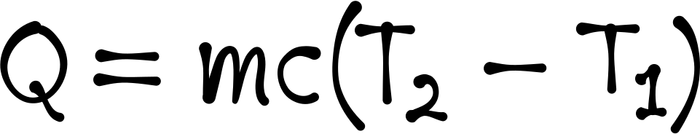


COURSE CONTENT
  Heat transfer mechanisms
  General heat conduction equation
  Steady heat conduction
  Thermal resistance concept
  Heat transfer from finned surfaces
  Time-dependent heat conduction
  Heat convection and heat radiation
Presented By Gürşah GÜRÜF

Slide 6



COURSE METHODS
  Lecture
  Problem Solving
  Question-Answer
  Brain Storming
  Practice
  Discussion techniques and methods
Presented By Gürşah GÜRÜF

Slide 7
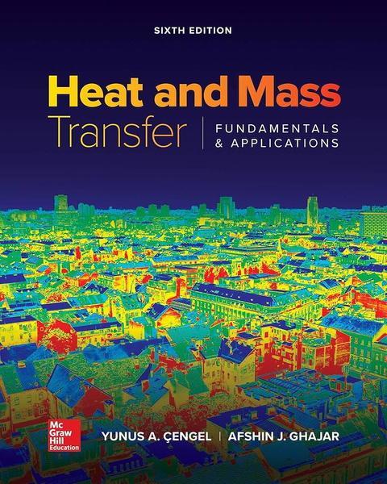
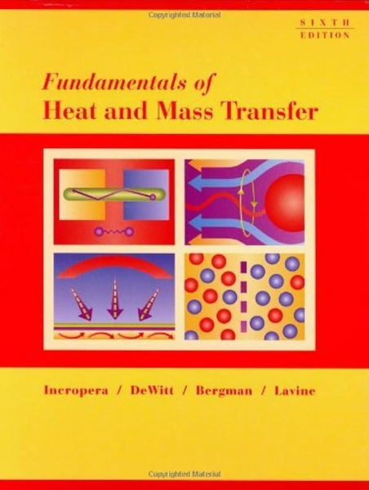
RESOURCES
Main
Assistant
Y. A. Çengel and A. J. Ghajar, Heat and Mass Transfer: Fundamentals and Applications, 6th Ed., McGraw-Hill, 2020.
F. P. Incropera and D. P. DeWitt, Fundamentals of Heat and Mass Transfer, 6th Ed., John Wiley, 2007.
Presented By Gürşah GÜRÜF

Slide 8
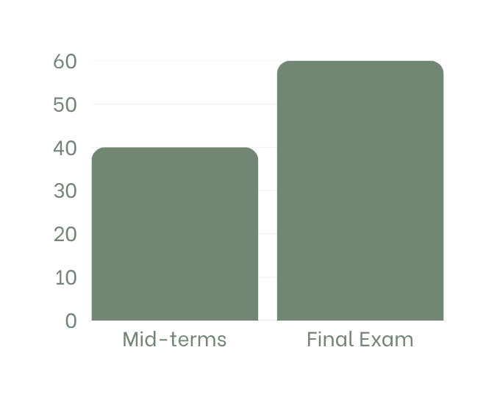
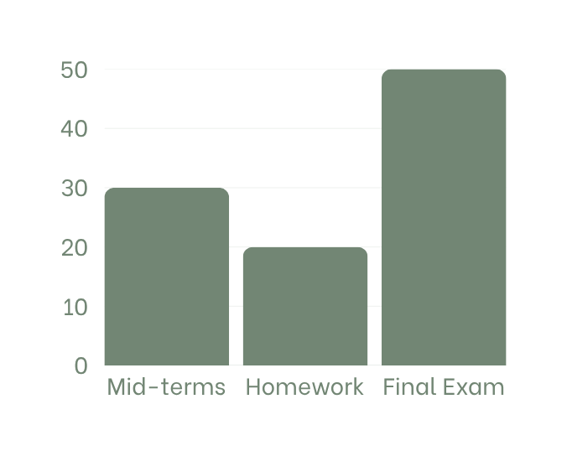
ASSESSMENT METHODS
First scenario
Second scenario
(Quantity 1)
(Quantity 1)
(Quantity 1)
(Quantity 1)
(Quantity 1)
Presented By Gürşah GÜRÜF

Slide 9
WEEKLY DETAILED COURSE CONTENTS
  Introduction and basic concepts, heat transfer mechanisms: conduction, convection, and radiation.
  One dimensional and general heat conduction equation.
  Boundary and initial conditions, solution of steady one-dimensional heat conduction problems.
  Solution of steady one-dimensional heat conduction problems, heat generation in a solid.
  Steady heat conduction in plane walls, thermal resistance concept and thermal resistance networks.
6.Heat conduction in cylinders and spheres.
7. Midterm
8. Heat transfer from finned surfaces.
9. Transient heat conduction, lumped system analysis.
10. Transient heat conduction in large plane walls, long cylinders and spheres with spatial effects.
11. Fundamentals of convection, quiz.
12. External forced convection.
13. Internal forced convection.
14. Natural convection.
15. Fundamentals of thermal radiation.
Final Exam
Presented By Gürşah GÜRÜF

Slide 10


COURSE LEARNING OUTCOMES
  Solves problems related to heat transfer mechanisms.
  Solves problems related to steady and transient heat transfer.
  Calculates convection heat transfer problems.
  Define boundary conditions and applies them to heat convection, conduction and radiation problems.
  Calculate forced external convection resistance and heat transfer.
Presented By Gürşah GÜRÜF

Slide 11
THANK YOU
Presented By Gürşah GÜRÜF

