Slide 1




MEE305 - HEAT TRANSFER
WEEK 2
CHAPTER 2: HEAT CONDUCTION EQUATION
Presented By Gürşah GÜRÜF

Slide 2
OBJECTIVES
When you finish studying this chapter, you should be able to:
  Understand multidimensionality and time dependence of heat transfer, and the conditions under which a heat transfer problem can be approximated as being one-dimensional,
  Obtain the differential equation of heat conduction in various coordinate systems, and simplify it for steady one-dimensional case,
  Identify the thermal conditions on surfaces, and express them mathematically as boundary and initial conditions,
  Solve one-dimensional heat conduction problems and obtain the temperature distributions within a medium and the heat flux,
  Analyze one-dimensional heat conduction in solids that involve heat generation, and
  Evaluate heat conduction in solids with temperature-dependent thermal conductivity.
Presented By Gürşah GÜRÜF

Slide 3
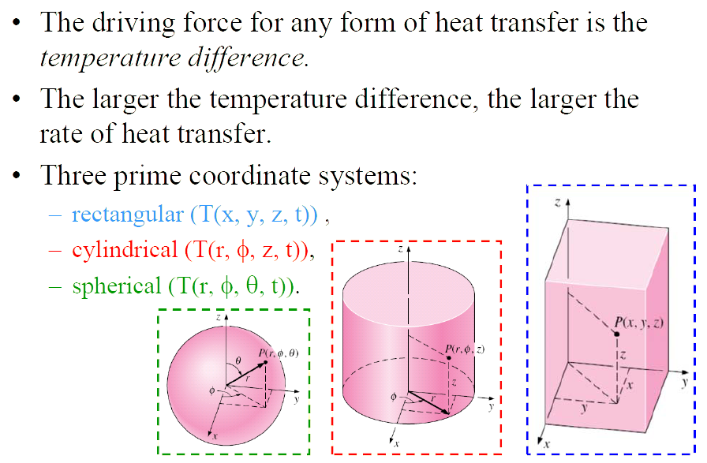
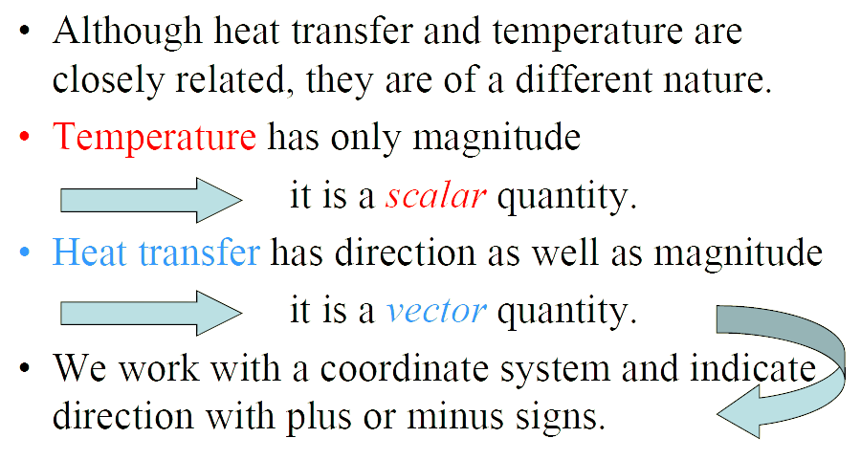
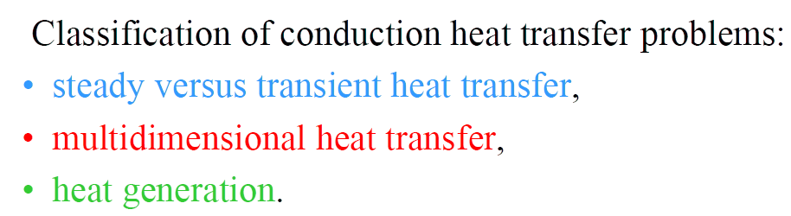
INTRODUCTION
Presented By Gürşah GÜRÜF

Slide 4
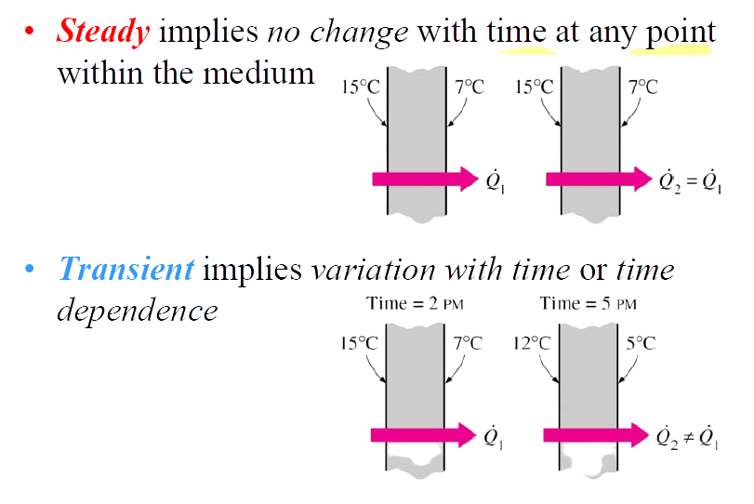
STEADY VERSUS TRANSIENT HEAT TRANSFER
Presented By Gürşah GÜRÜF

Slide 5
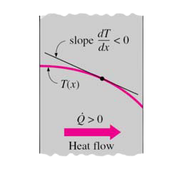

MULTIDIMENSIONAL HEAT TRANSFER
Heat transfer problems are also classified as being:
  one-dimensional,
  two dimensional,
  three-dimensional.
In the most general case, heat transfer through a medium is three-dimensional. However, some problems can be classified as two- or one-dimensional depending on the relative magnitudes of heat transfer rates in different directions and the level of accuracy desired.
The rate of heat conduction through a medium in a specified direction (say, in the x-direction) is expressed by Fourier’s law of heat conduction for one-dimensional heat conduction as:
Heat is conducted in the direction of decreasing temperature, and thus the temperature gradient is negative when heat is conducted in the positive xdirection.
Presented By Gürşah GÜRÜF

Slide 6
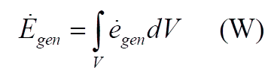
HEAT GENERATION
Examples:
  electrical energy being converted to heat at a rate of I2R,
  fuel elements of nuclear reactors,
  exothermic chemical reactions.
Heat generation is a volumetric phenomenon.
The rate of heat generation units : W/m3
The rate of heat generation in a medium may vary with time as well as position within the medium.
The total rate of heat generation in a medium of volume V can be determined from
Presented By Gürşah GÜRÜF

Slide 7
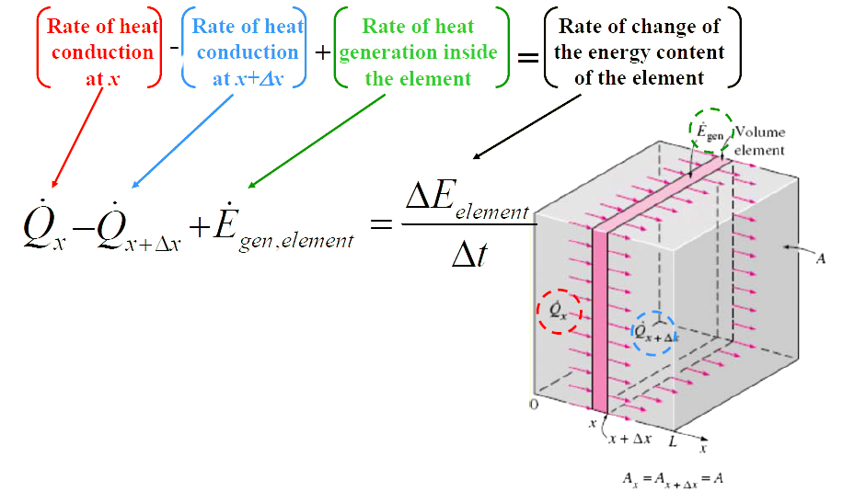
ONE-DIMENSIONAL HEAT CONDUCTION
EQUATION - PLANE WALL
Presented By Gürşah GÜRÜF

Slide 8
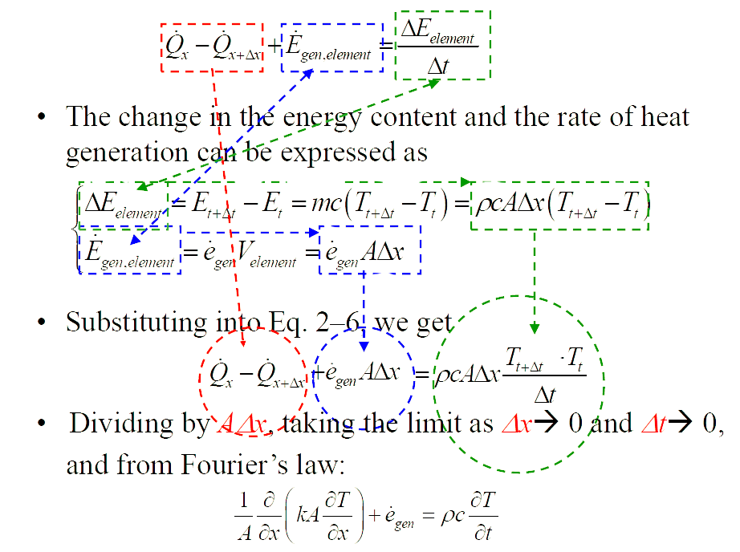
Presented By Gürşah GÜRÜF

Slide 9
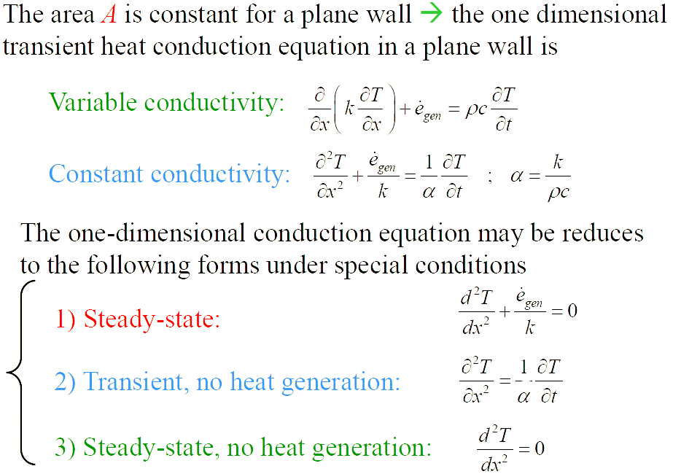
Presented By Gürşah GÜRÜF

Slide 10
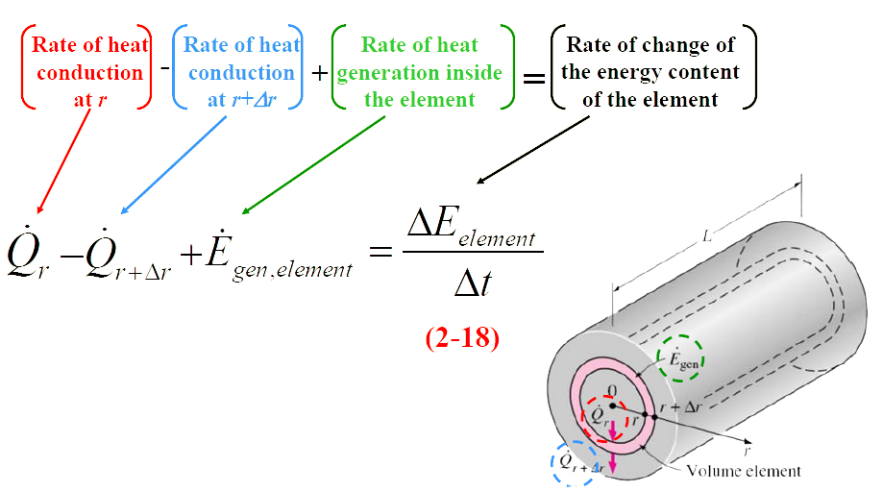
ONE-DIMENSIONAL HEAT CONDUCTION
EQUATION - LONG CYLINDER
Presented By Gürşah GÜRÜF

Slide 11
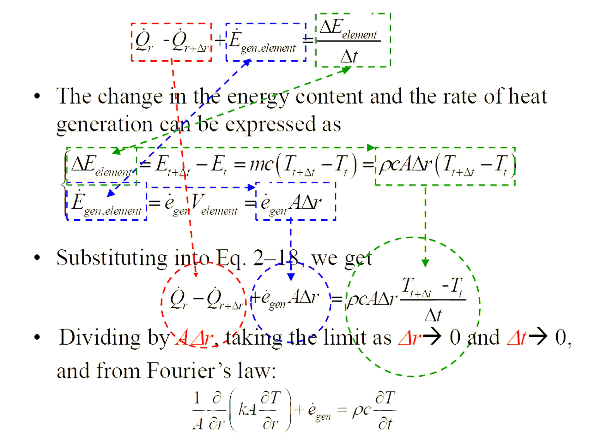
Presented By Gürşah GÜRÜF

Slide 12
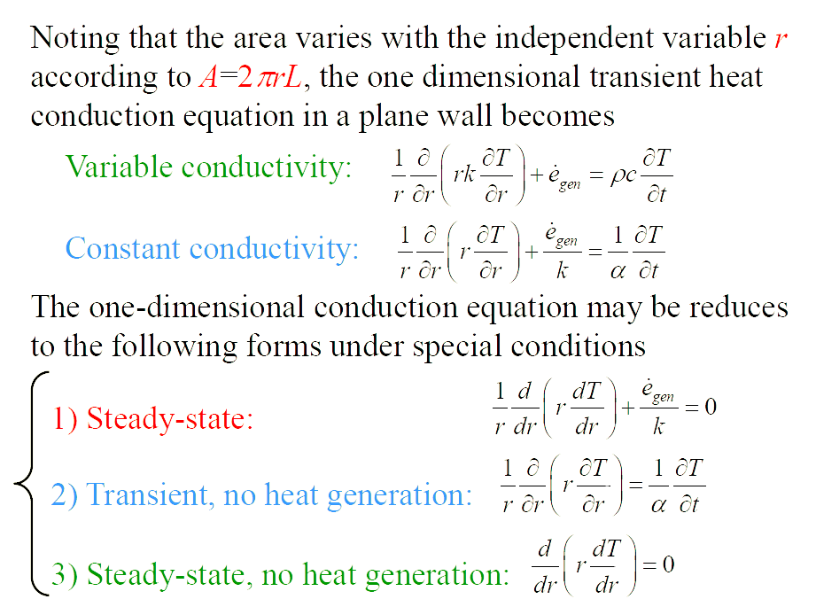
Presented By Gürşah GÜRÜF

Slide 13
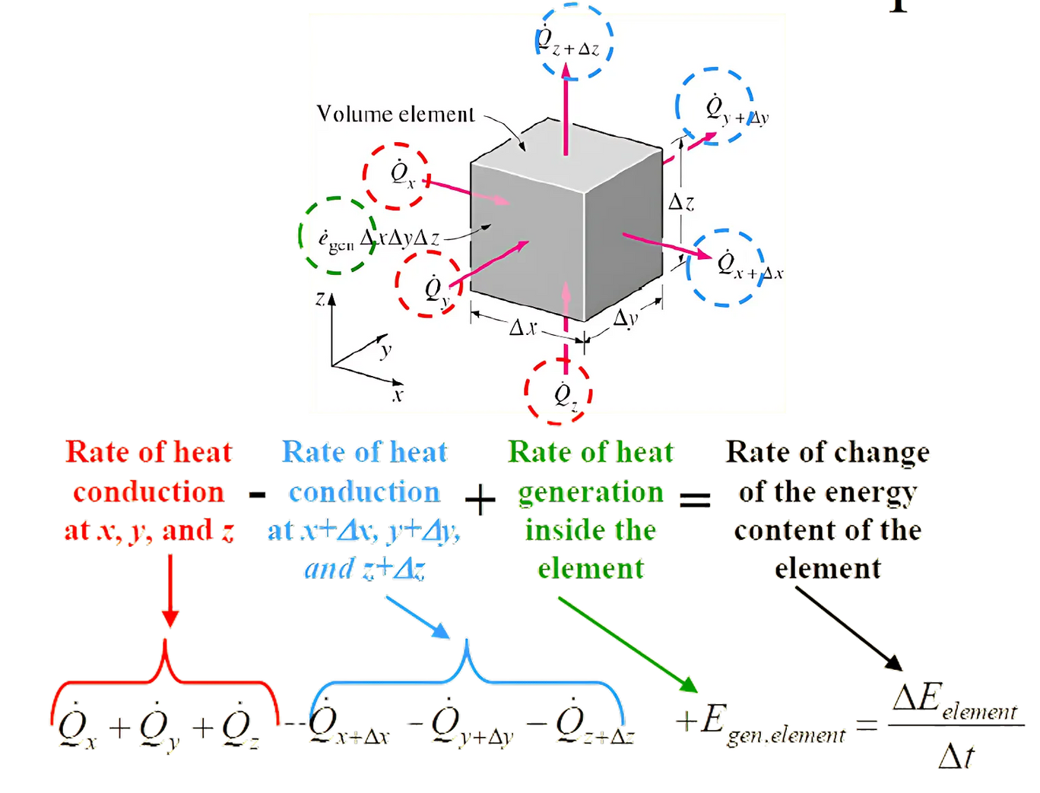
GENERAL HEAT CONDUCTION EQUATION
Presented By Gürşah GÜRÜF

Slide 14
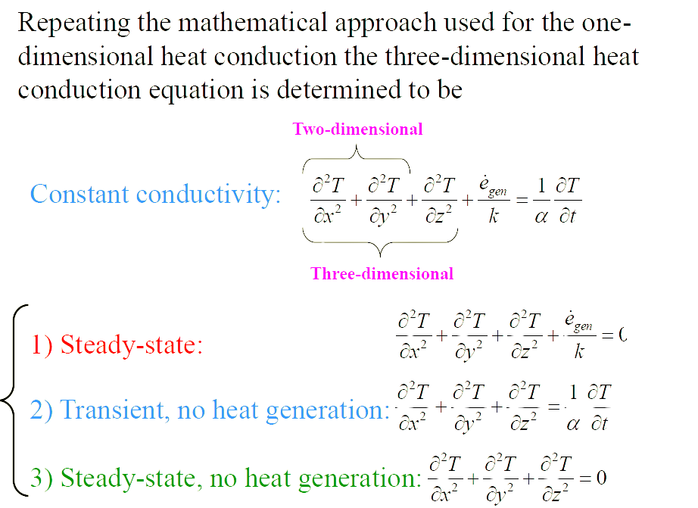
GENERAL HEAT CONDUCTION EQUATION
Presented By Gürşah GÜRÜF

Slide 15
THANK YOU
Presented By Gürşah GÜRÜF

