Slide 1




MEE305 - HEAT TRANSFER
WEEK 1
CHAPTER 1: INTRODUCTION AND BASIC CONCEPTS
Presented By Gürşah GÜRÜF

Slide 2
OBJECTIVES
When you finish studying this chapter, you should be able to:,
  Understand how thermodynamics and heat transfer are related to each other,
  Distinguish thermal energy from other forms of energy, and heat transfer from other forms of energy transfer,
  Perform general energy balances as well as surface energy balances,
  Understand the basic mechanisms of heat transfer, which are conduction, convection, and radiation, and Fourier's law of heat conduction, Newton's law of cooling, and the Stefan–Boltzmann law of radiation,
  Identify the mechanisms of heat transfer that occur simultaneously in practice,
  Develop an awareness of the cost associated with heat losses, and
  Solve various heat transfer problems encountered in practice.
Presented By Gürşah GÜRÜF

Slide 3
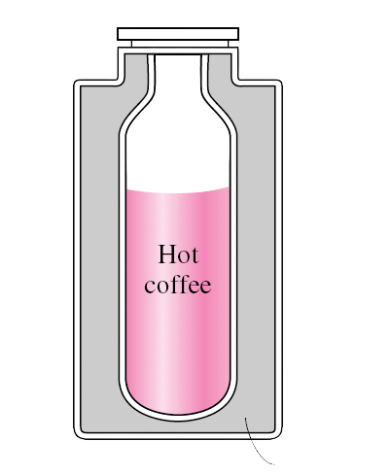
THERMODYNAMICS AND HEAT TRANSFER
  The science of thermodynamics deals with the amount of heat transfer as a system undergoes a process from one equilibrium state to another, and makes no reference to how long the process will take.
  The science of heat transfer deals with the determination of the rates of energy that can be transferred from one system to another as a result of temperature difference.
Thermos
bottle
Insulation
Presented By Gürşah GÜRÜF

Slide 4
THERMODYNAMICS AND HEAT TRANSFER
  Thermodynamics deals with equilibrium states and changes from one equilibrium state to another. Heat transfer, on the other hand, deals with systems that lack thermal equilibrium, and thus it is a nonequilibrium phenomenon.
  Therefore, the study of heat transfer cannot be based on the principles of thermodynamics alone.
  However, the laws of thermodynamics lay the framework for the science of heat transfer.
Presented By Gürşah GÜRÜF

Slide 5
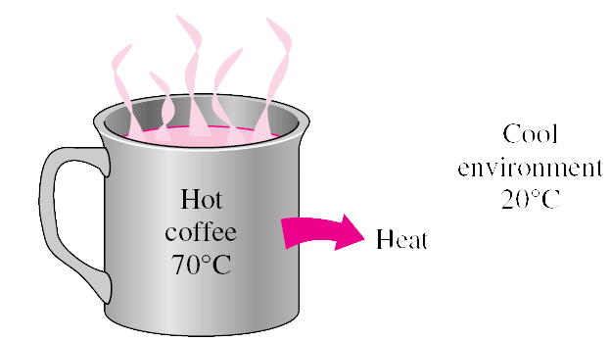
HEAT TRANSFER
  The basic requirement for heat transfer is the presence of a temperature difference.
  The second law requires that heat be transferred in the direction of decreasing temperature.
  The temperature difference is the driving force for heat transfer.
  The rate of heat transfer in a certain direction depends on the magnitude of the temperature gradient in that direction.
  The larger the temperature gradient, the higher the rate of heat transfer.
Presented By Gürşah GÜRÜF

Slide 6
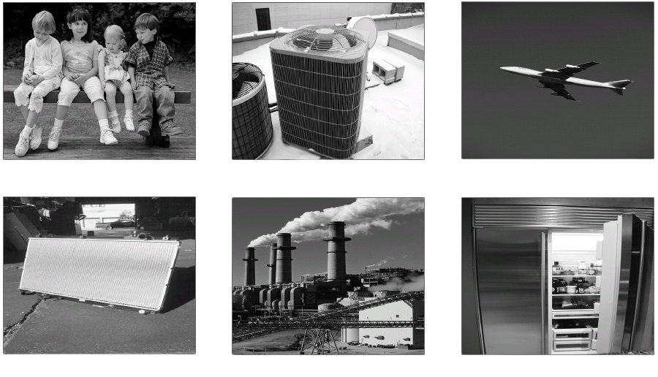
APPLICATION AREAS OF HEAT TRANSFER
Presented By Gürşah GÜRÜF

Slide 7


HEAT AND OTHER FORMS OF ENERGY
Energy can exist in numerous forms such as:
  thermal,
  mechanical,
  kinetic,
  potential,
  electrical,
  magnetic,
  chemical, and
  nuclear.
Their sum constitutes the total energy E (or e on a unit mass basis) of a system.
The sum of all microscopic forms of energy is called the internal energy of a system.
Presented By Gürşah GÜRÜF

Slide 8



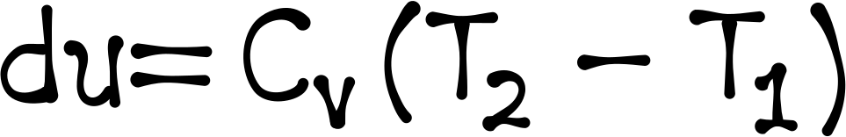
HEAT AND OTHER FORMS OF ENERGY
  Internal energy may be viewed as the sum of the kinetic and potential energies of the molecules.
  The kinetic energy of the molecules is called sensible heat.
  The internal energy associated with the phase of a system is called latent heat.
  The internal energy associated with the atomic bonds in a molecule is called chemical (or bond) energy.
  The internal energy associated with the bonds within the nucleus of the atom itself is called nuclear energy.
Presented By Gürşah GÜRÜF

Slide 9
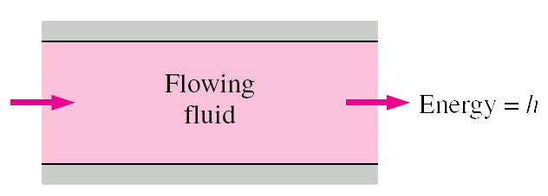
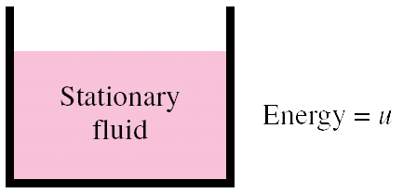
INTERNAL ENERGY AND ENTHALPY
  In the analysis of systems that involve fluid flow, we frequently encounter the combination of properties u and P υ.
  The combination is defined as enthalpy (h=u+P υ).
  The term Pυ represents the flow energy of the fluid (also called the flow work).
Presented By Gürşah GÜRÜF

Slide 10
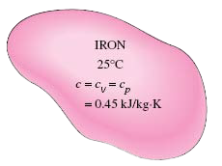
SPECIFIC HEATS
  Specific heat is defined as the energy required to raise the temperature of a unit mass of a substance by one degree.
  Two kinds of specific heats:
- specific heat at constant volume cv, and
- specific heat at constant pressure cp.
  The specific heats of a substance, in general, depend on two independent properties such as temperature and pressure.
  For an ideal gas, however, they depend on temperature only.
  At low pressures all real gases approach ideal gas behavior, and therefore their specific heats depend on temperature only.
  A substance whose specific volume (or density) does not change with temperature or pressure is called an incompressible substance.
  The constant-volume and constant-pressure specific heats are identical for incompressible substances.
  The specific heats of incompressible substances depend on temperature only.
Presented By Gürşah GÜRÜF

Slide 11
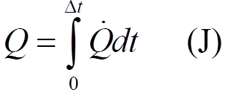
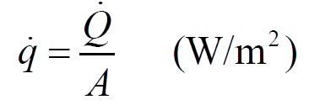
ENERGY TRANSFER
Energy can be transferred to or from a given mass by two mechanisms:
  heat transfer, and
  work.
The amount of heat transferred during a process is denoted by Q.
The amount of heat transferred per unit time is called heat transfer rate, and is denoted by Q.
The total amount of heat transfer Q during a time interval Δt can be determined from
The rate of heat transfer per unit area normal to the direction of heat transfer is called heat flux, and the average heat flux is expressed as
Presented By Gürşah GÜRÜF

Slide 12
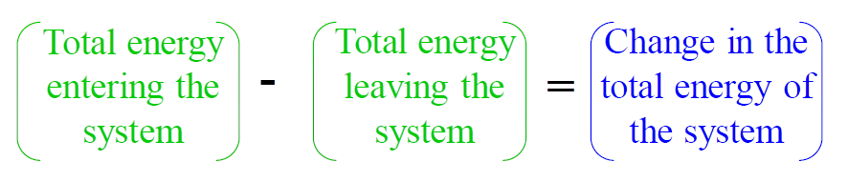
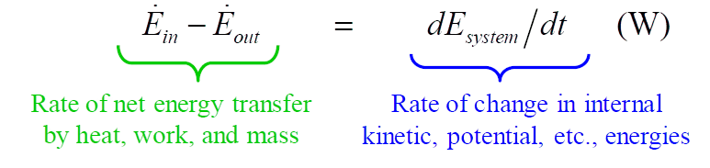
THE FIRST LAW OF THERMODYNAMICS
  The first law of thermodynamics states that energy can neither be created nor destroyed during a process; it can only change forms.
  The energy balance for any system undergoing any process can be expressed as (in the rate form)
Presented By Gürşah GÜRÜF

Slide 13
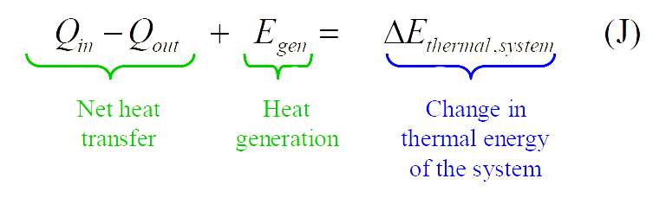
THE FIRST LAW OF THERMODYNAMICS
  In heat transfer problems it is convenient to write a heat balance and to treat the conversion of nuclear, chemical, mechanical, and electrical energies into thermal energy as heat generation.
  The energy balance in that case can be expressed as
Presented By Gürşah GÜRÜF

Slide 14



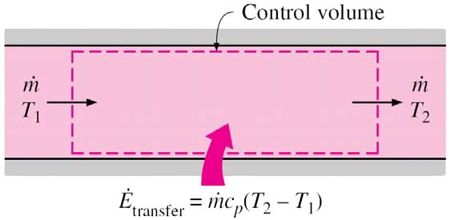
ENERGY BALANCE
Closed Systems
Steady-Flow Systems
  Stationary closed system, no work:
  For system with one inlet and one exit:
  When kinetic and potential energies are negligible, and there is no work interaction
Presented By Gürşah GÜRÜF

Slide 15
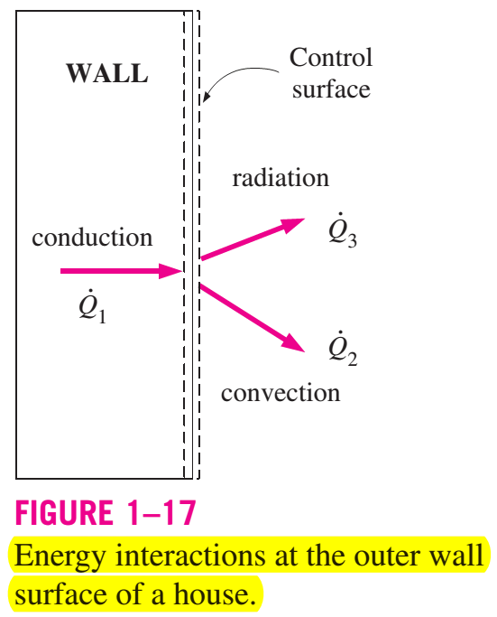

SURFACE ENERGY BALANCE
A surface contains no volume or mass, and thus no energy. Thereore, a surface can be viewed as a fictitious system whose energy content remains constant during a process (just like a steady-state or steady-flowsystem)
Presented By Gürşah GÜRÜF

Slide 16
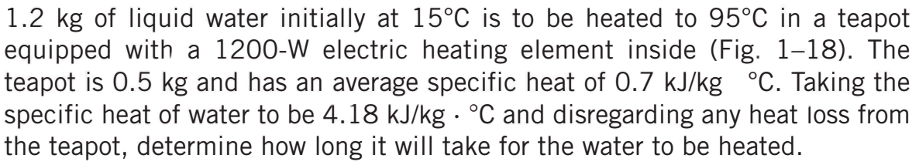
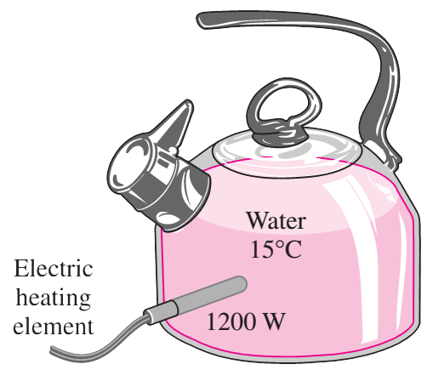
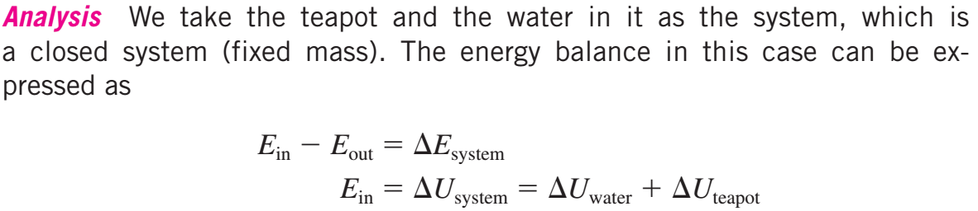
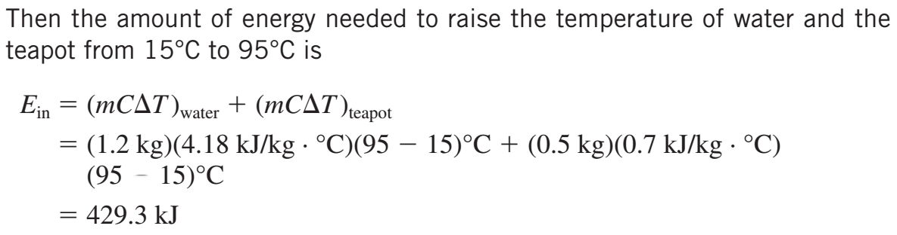
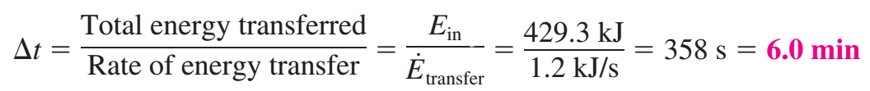
EXAMPLE
HEATING OF WATER IN AN ELECTRIC TEAPOT
Presented By Gürşah GÜRÜF

Slide 17
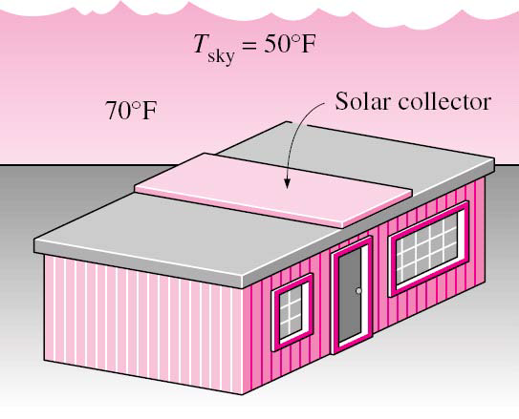
HEAT TRANSFER MECHANISMS
Heat can be transferred in three basic modes:
  conduction,
  convection,
  radiation.
All modes of heat transfer require the existence of a temperature difference.
All modes are from the high-temperature medium to a lower-temperature one.
Presented By Gürşah GÜRÜF

Slide 18
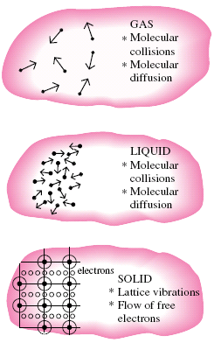
CONDUCTION
Conduction is the transfer of energy from the more energetic particles of a substance to the adjacent less energetic ones as a result of interactions between the particles.
Conduction can take place in solids, liquids, or gases
  In gases and liquids conduction is due to the collisions and diffusion of the molecules during their random motion.
  In solids conduction is due to the combination of vibrations of the molecules in a lattice and the energy
  transport by free electrons.
Presented By Gürşah GÜRÜF

Slide 19
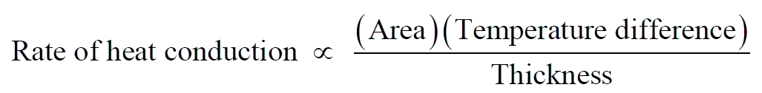
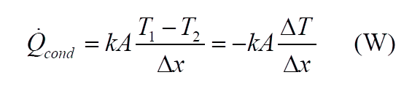
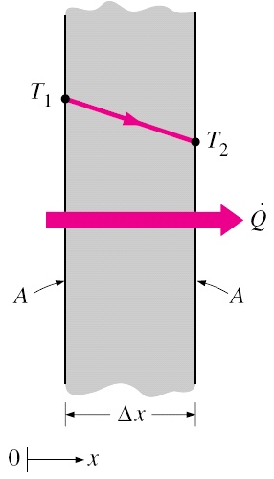
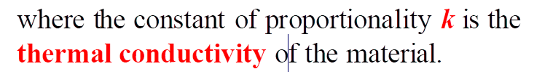
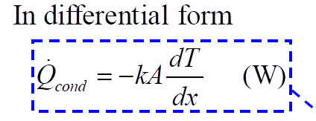
CONDUCTION
Presented By Gürşah GÜRÜF

Slide 20
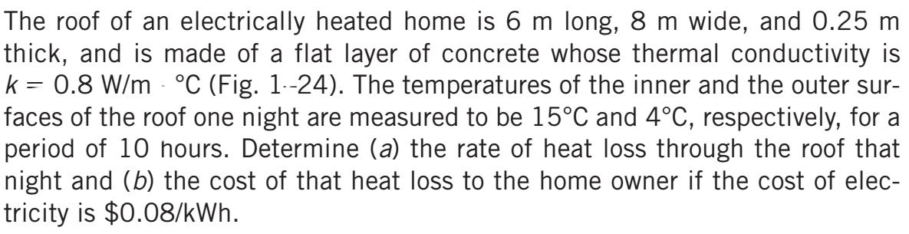
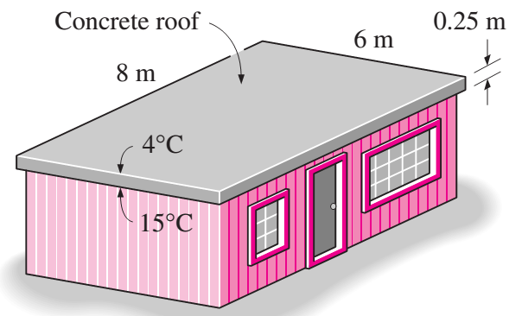
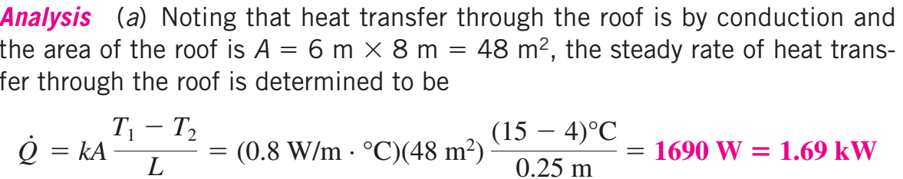
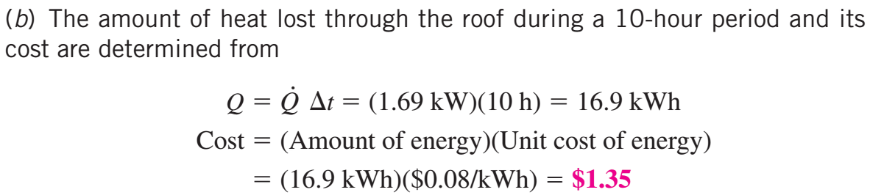
EXAMPLE
THE COST OF HEAT LOSS THROUGH A ROOF
Presented By Gürşah GÜRÜF

Slide 21
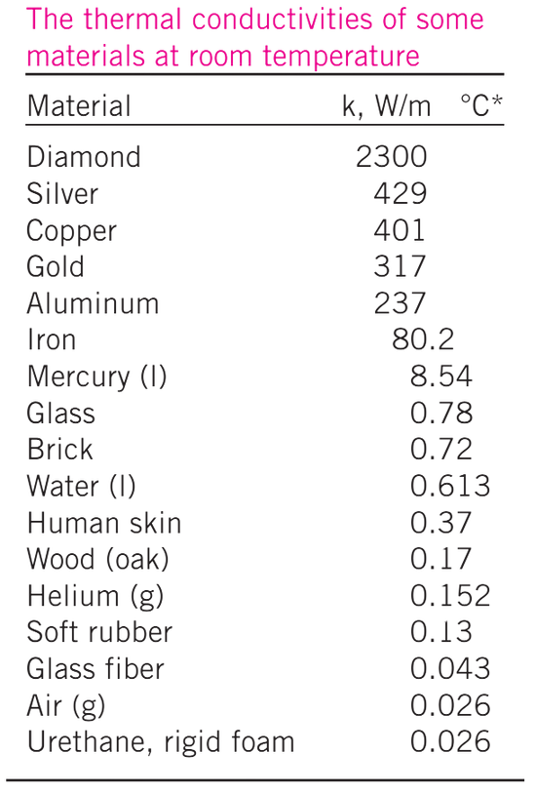
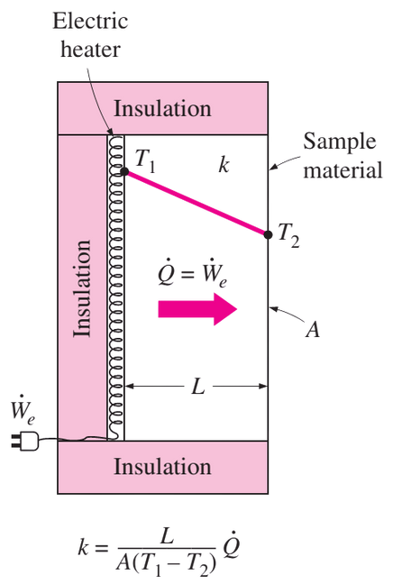
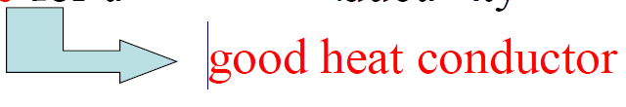
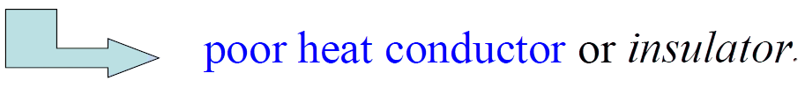
THERMAL CONDUCTIVITY
  The thermal conductivity of a material is a measure of the ability of the material to conduct heat.
  High value for thermal conductivity
  Low value
A simple experimental setup to determine the thermal conductivity of a material
Presented By Gürşah GÜRÜF

Slide 22
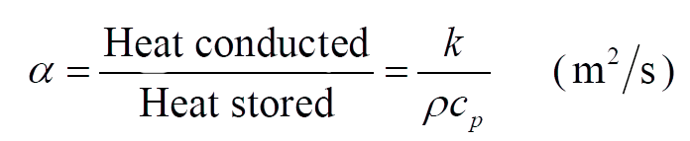
THERMAL DIFFUSIVITY
  The thermal diffusivity represents how fast heat diffuses through a material.
  Appears in the transient heat conduction analysis.
  A material that has a high thermal conductivity or a low heat capacity will have a large thermal diffusivity.
  The larger the thermal diffusivity, the faster the propagation of heat into the medium.
Presented By Gürşah GÜRÜF

Slide 23
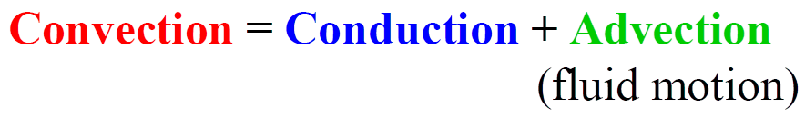
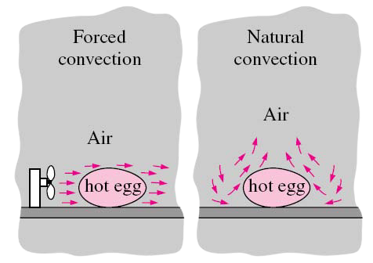
CONVECTION
Convection is the mode of energy transfer between a solid surface and the adjacent liquid or gas that is in motion.
Convection is commonly classified into three sub-modes:
  Forced convection,
  Natural (or free) convection,
  Change of phase (liquid/vapor, solid/liquid, etc.)
Presented By Gürşah GÜRÜF

Slide 24
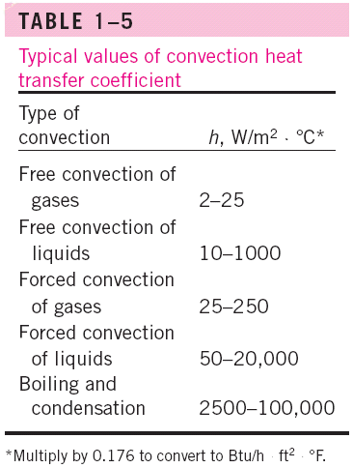

CONVECTION
  The rate of convection heat transfer is expressed by Newton’s law of cooling as
  h is the convection heat transfer coefficient in W/m2°C.
  h depends on variables such as the surface geometry, the nature of fluid motion, the properties of the fluid, and the bulk fluid velocity.
Presented By Gürşah GÜRÜF

Slide 25

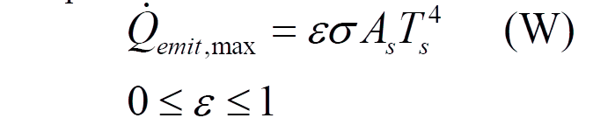
RADIATION
  Radiation is the energy emitted by matter in the form of electromagnetic waves (or photons) as a result of the changes in the electronic configurations of the atoms or molecules.
  Heat transfer by radiation does not require the presence of an intervening medium.
  In heat transfer studies we are interested in thermal radiation (radiation emitted by bodies because of their temperature).
  Radiation is a volumetric phenomenon. However, radiation is usually considered to be a surface phenomenon for solids that are opaque to thermal radiation.
  The maximum rate of radiation that can be emitted from a surface at a thermodynamic temperature Ts (in K or R) is given by the Stefan–Boltzmann law as
  σ =5.670X108 W/m2·K4 is the Stefan–Boltzmann constant.
  The idealized surface that emits radiation at this maximum rate is called a blackbody.
  The radiation emitted by all real surfaces is less than the radiation emitted by a blackbody at the same temperature, and is expressed as
  ε is the emissivity of the surface.
Presented By Gürşah GÜRÜF

Slide 26

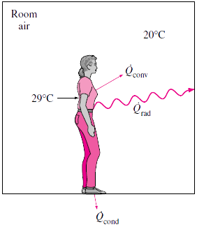
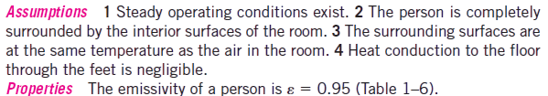

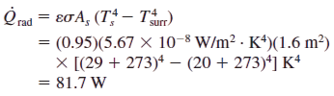
EXAMPLE
HEAT LOSS FROM A PERSON
Presented By Gürşah GÜRÜF

Slide 27
THANK YOU
Presented By Gürşah GÜRÜF

