Slide 1




MEE302 - FLUID MECHANICS II
COURSE DESCRIPTION AND INFORMATION
Presented By Gürşah GÜRÜF

Slide 2
OVERVIEW
  Course Details
  Resources
  Objectives of the Course
  Assessment Methods
  Course Content
  Weekly Detailed Course Contents
  Course Methods
  Course Learning Outcomes
Presented By Gürşah GÜRÜF

Slide 3
COURSE DETAILS
Course Unit Code: MEE302
Course Unit Title: Fluid Mechanics II
Semester: 6
T+P+L: 3+0+0
Credit: 3
Number of ECTS Credits: 3
Department / Program: Mechanical Engineering
Type of Program: Formal Education
Type of Course Unit: Compulsory
Course Delivery Method: Face To Face
Presented By Gürşah GÜRÜF

Slide 4


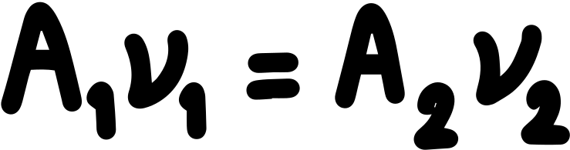
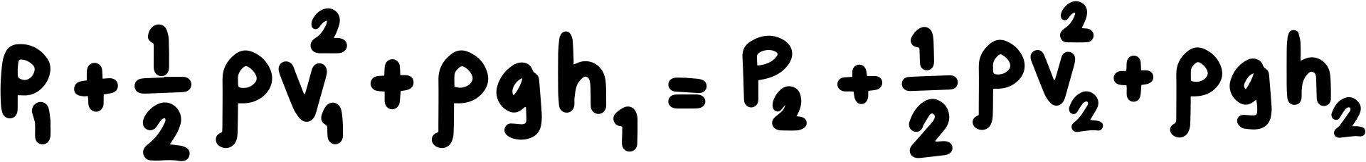
OBJECTIVES OF THE COURSE
It aims to teach methods for deriving the basic equations in the differential form used in the analysis of engineering problems involving fluids or defining fluids by introducing the basic properties of fluids, their place and their importance in engineering applications, and to help students gain the skills to develop solutions in this context.
Presented By Gürşah GÜRÜF

Slide 5



COURSE CONTENT
  It is structured to produce solutions using engineering approaches to Bernoulli and energy equations, momentum equations, incompressible viscous flow, Navier-Stokes equations, boundary layer in laminar and turbulent flow, incompressible flows and solutions in closed channels and pipes, flow around immersed objects and compressible flow.
Presented By Gürşah GÜRÜF

Slide 6



COURSE METHODS
  Lecture
  Problem Solving
  Question-Answer
  Brain Storming
  Practice
  Discussion techniques and methods
Presented By Gürşah GÜRÜF

Slide 7
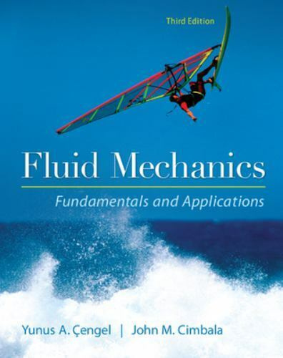
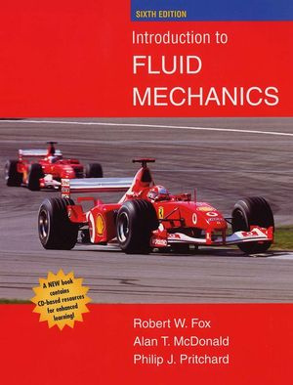
RESOURCES
Main
Assistant
Fluid Mechanics Fundamentals and Applications, Yunus Cengel, John Cimbala, McGraw-Hill Education; 3 edition (January 30, 2013)
Introduction to Fluid Mechanics, R. W. Fox, P. J. Pritchard and A. T. McDonald, John Wiley & Sons, Inc.
Presented By Gürşah GÜRÜF

Slide 8
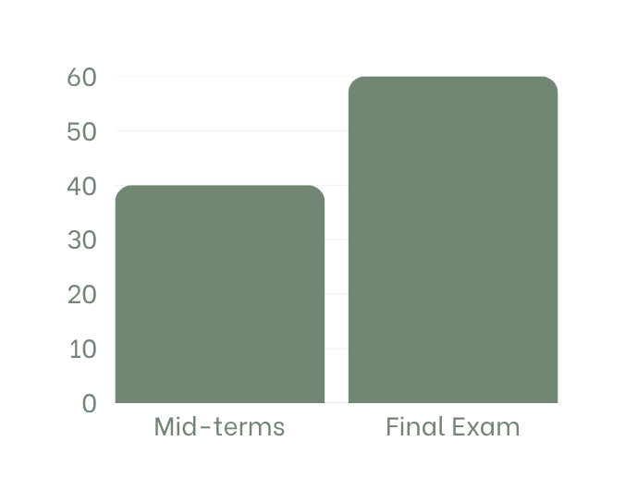
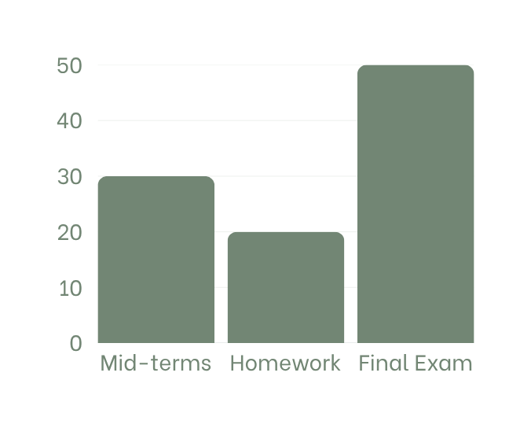
ASSESSMENT METHODS
First scenario
Second scenario
(Quantity 1)
(Quantity 1)
(Quantity 1)
(Quantity 1)
(Quantity 1)
Presented By Gürşah GÜRÜF

Slide 9
WEEKLY DETAILED COURSE CONTENTS
  BERNOULLI EQUATION
  GENERAL ENERGY EQUATION
  LINEAR MOMENTUM EQUATION
  LINEAR MOMENTUM EQUATION
  ANGULAR MOMENTUM EQUATION
  ANGULAR MOMENTUM EQUATION
  MIDTERM
8. INTERNAL FLOW
9. INTERNAL FLOW
10. INTERNAL FLOW
11. EXTERNAL FLOW
12. EXTERNAL FLOW
13. EXTERNAL FLOW
14. COMPRESSIBLE FLOW
15. COMPRESSIBLE FLOW
FINAL EXAM
Presented By Gürşah GÜRÜF

Slide 10


COURSE LEARNING OUTCOMES
  Solves energy problems using Bernoulli and Energy equations.
  Calculate the forces and moments applied to the body by the fluid.
  Defines and solves fluid problems about internal flow.
  Defines and solves fluid problems about external flow.
  Solves fluid problems on compressible flow.
Presented By Gürşah GÜRÜF

Slide 11
THANK YOU
Presented By Gürşah GÜRÜF

