Slide 1




MEE301 - FLUID MECHANICS I
COURSE DESCRIPTION AND INFORMATION
Presented By Gürşah GÜRÜF

Slide 2
OVERVIEW
  Course Details
  Resources
  Objectives of the Course
  Assessment Methods
  Course Content
  Weekly Detailed Course Contents
  Course Methods
  Course Learning Outcomes
Presented By Gürşah GÜRÜF

Slide 3
COURSE DETAILS
Course Unit Code: MEE301
Course Unit Title: Fluid Mechanics I
Semester: 5
T+P+L: 3+0+0
Credit: 3
Number of ECTS Credits: 3
Department / Program: Mechanical Engineering
Type of Program: Formal Education
Type of Course Unit: Compulsory
Course Delivery Method: Face To Face
Presented By Gürşah GÜRÜF

Slide 4


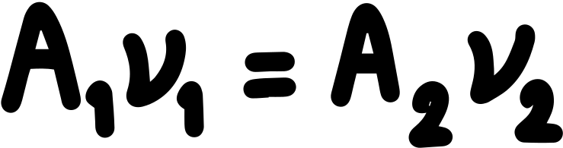
OBJECTIVES OF THE COURSE
It aims to teach the methods used in analysing engineering problems involving fluids by introducing the basic properties of fluids and their place and importance in engineering applications and to gain the skills to develop solutions in this context.
Presented By Gürşah GÜRÜF

Slide 5



COURSE CONTENT
  Introduction to fluid mechanics
  Definition and classification of fluid motion
  Fluid statics
  Llift and stability,
  Fluids undergoing rigid body motion
  Derivation and application of basic equations in integral form using control volumes, and use of and application of general energy balance.
Presented By Gürşah GÜRÜF

Slide 6



COURSE METHODS
  Lecture
  Problem Solving
  Question-Answer
  Brain Storming
  Practice
  Discussion techniques and methods
Presented By Gürşah GÜRÜF

Slide 7
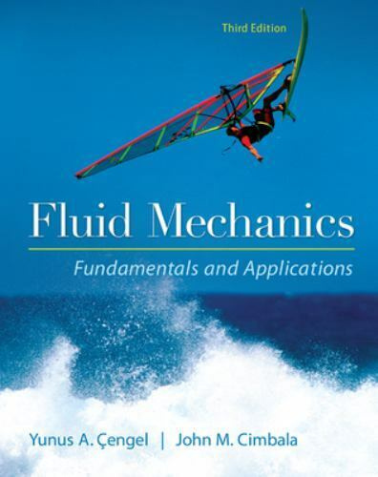
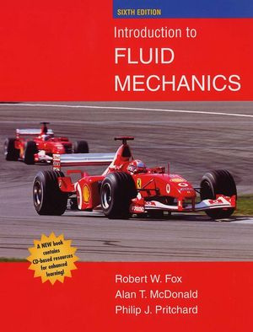
RESOURCES
Main
Assistant
Fluid Mechanics Fundamentals and Applications, Yunus Cengel, John Cimbala, McGraw-Hill Education; 3 edition (January 30, 2013)
Introduction to Fluid Mechanics, R. W. Fox, P. J. Pritchard and A. T. McDonald, John Wiley & Sons, Inc.
Presented By Gürşah GÜRÜF

Slide 8
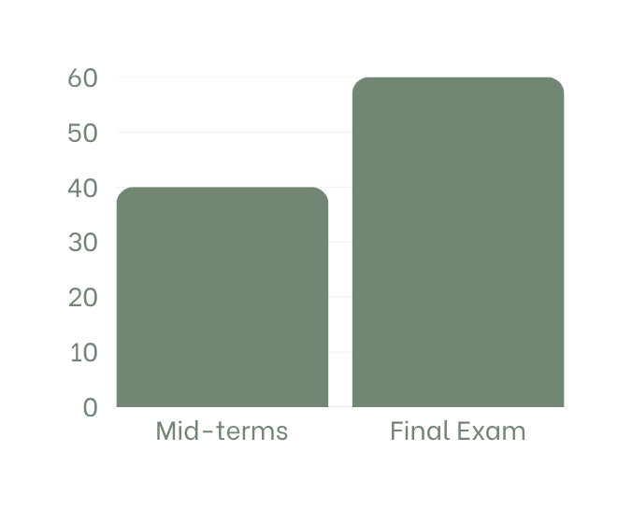
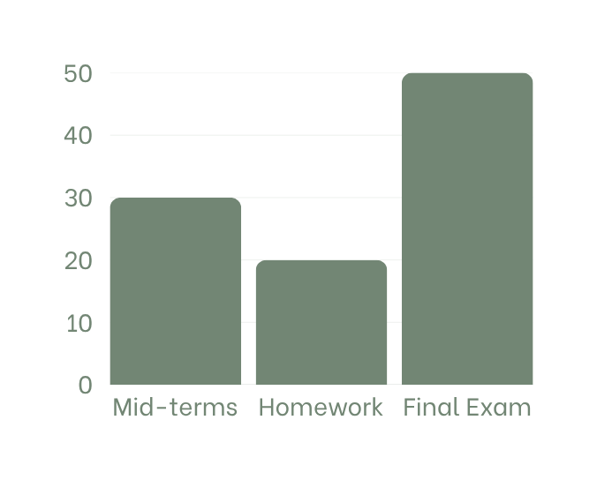
ASSESSMENT METHODS
First scenario
Second scenario
(Quantity 1)
(Quantity 1)
(Quantity 1)
(Quantity 1)
(Quantity 1)
Presented By Gürşah GÜRÜF

Slide 9
WEEKLY DETAILED COURSE CONTENTS
  Definition of fluid, fluid mechanics in engineering, scope of fluid mechanics, methods of analysis, dimensions and units.
  System, Control Volume and Control Surface, Problem Solving techniques
  Definition of continuum, fluid as a continuum, velocity field, timeline.
  Fluids pathline, streakline and streamline. Stress field.
  Fluids Viscosity, Newtonian and non-Newtonian fluids
  Vapor pressure and surface tension, description and classification of fluid motion.
7. Midterm
8. The basic equation of fluid statics
9. Analysis of hydrostatic force on curved submerged surfaces.
10. Buoyancy and stability.
11. Analysis of fluids in rigid-body motion.
12. Conservation of Mass and Energy
13. Bernoulli and Energy Equations Introduction
14. Conservation of Mass, Mechanical Energy and Efficiency
15. General Energy Equation, Energy Analysis of Steady Flows
Final Exam
Presented By Gürşah GÜRÜF

Slide 10


COURSE LEARNING OUTCOMES
  Knows the basic properties, basic concepts and classifications of fluid mechanics.Defines problem definition.
  Defines fluid statics, hydrostatic force acting on submerged surfaces a and solves related problems.
  Analyzes the rigid body motion objects.
  Knows Bernoulli and Energy equations, makes energy analysis using general energy equations.
  Define flow properties and analyzes flow using mass and energy balance.
Presented By Gürşah GÜRÜF

Slide 11
THANK YOU
Presented By Gürşah GÜRÜF

