Slide 1




MEE301 - FLUID MECHANICS I
WEEK 1
CHAPTER 1: INTRODUCTION AND BASIC CONCEPTS
Presented By Gürşah GÜRÜF

Slide 2
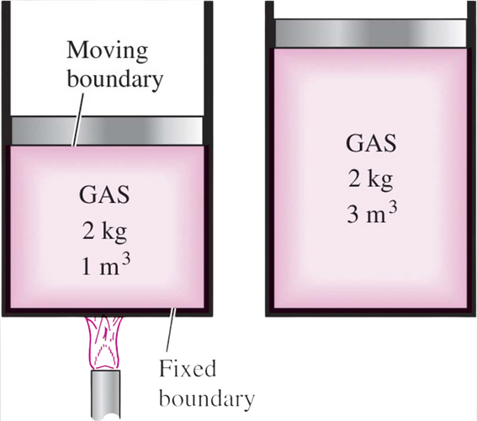
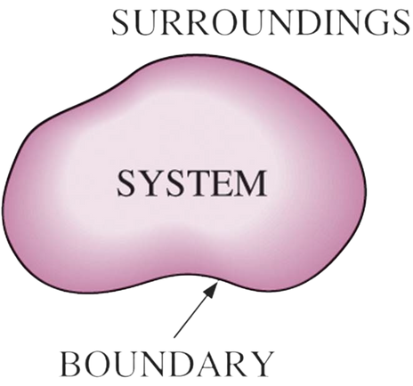
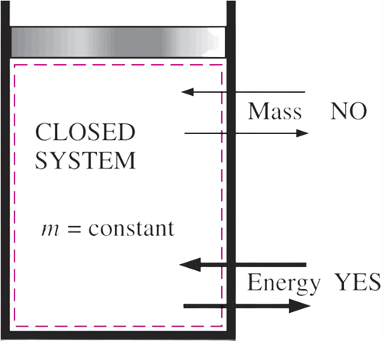
SYSTEM AND CONTROL VOLUME
System: A quantity of matter or a region in space chosen for study.
• Surroundings: The mass or region outside the system
• Boundary: The real or imaginary surface that separates the system from its surroundings.
• The boundary of a system can be fixed or movable.
• Systems may be considered to be closed or open.
• Closed system (Control mass): A fixed amount of mass, and no mass can cross its boundary.
Presented By Gürşah GÜRÜF

Slide 3
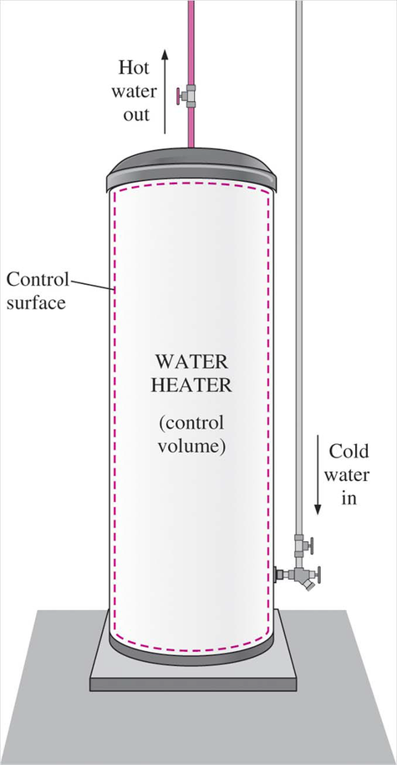
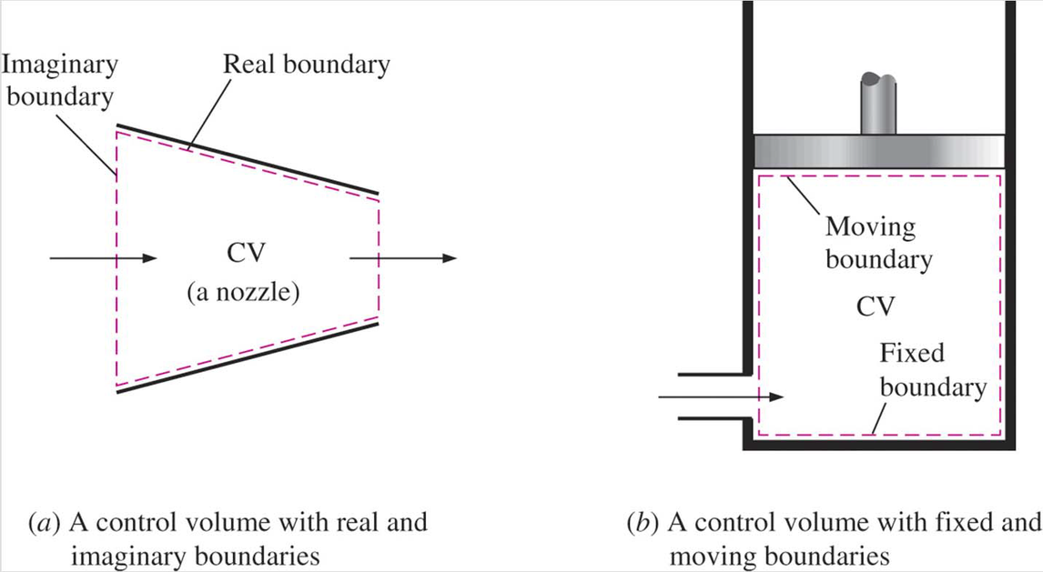
SYSTEM AND CONTROL VOLUME
Open system (control volume): A properly selected region in space.
• It usually encloses a device that involves mass flow such as a compressor, turbine, or nozzle.
• Both mass and energy can cross the boundary of a control volume.
• Control surface: The boundaries of a control volume. It can be real or imaginary.
Presented By Gürşah GÜRÜF

Slide 4
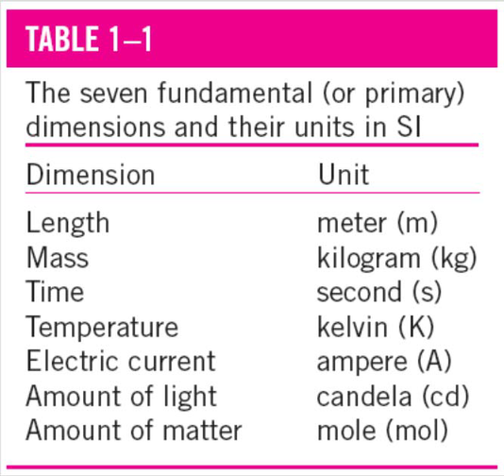
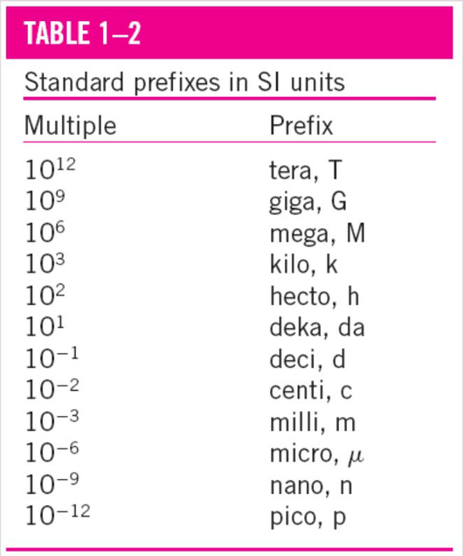
IMPORTANCE OF DIMENSIONS AND UNITS
  Any physical quantity can be characterized by dimensions.
  The magnitudes assigned to the dimensions are called units.
  Some basic dimensions such as mass m, length L, time t, and temperature T are selected as primary or fundamental dimensions, while others such as velocity V, energy E, and volume V are expressed in terms of the primary dimensions and are called secondary dimensions, or derived dimensions.
  Metric SI system: A simple and logical system based on a decimal relationship between the various units.
  English system: It has no apparent systematic numerical base, and various units in this system are related to each other rather arbitrarily.
Presented By Gürşah GÜRÜF

Slide 5
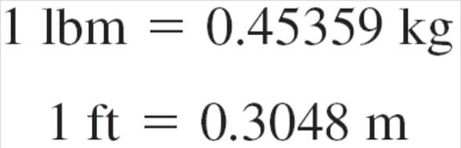
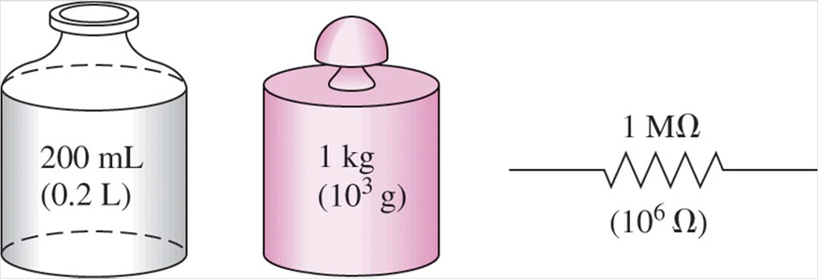

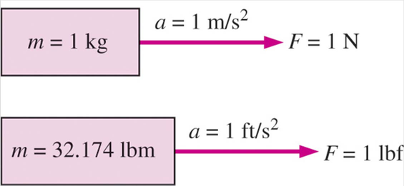
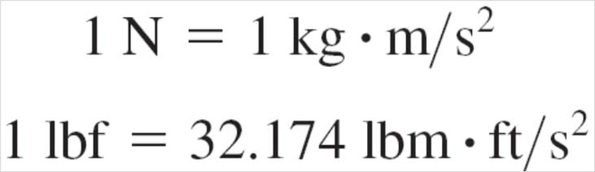
SOME SI AND ENGLISH UNITS
Work = Force x Distance
1 J = 1 N·m
1 cal = 4.1868 J
1 Btu = 1.0551 kJ
Presented By Gürşah GÜRÜF

Slide 6

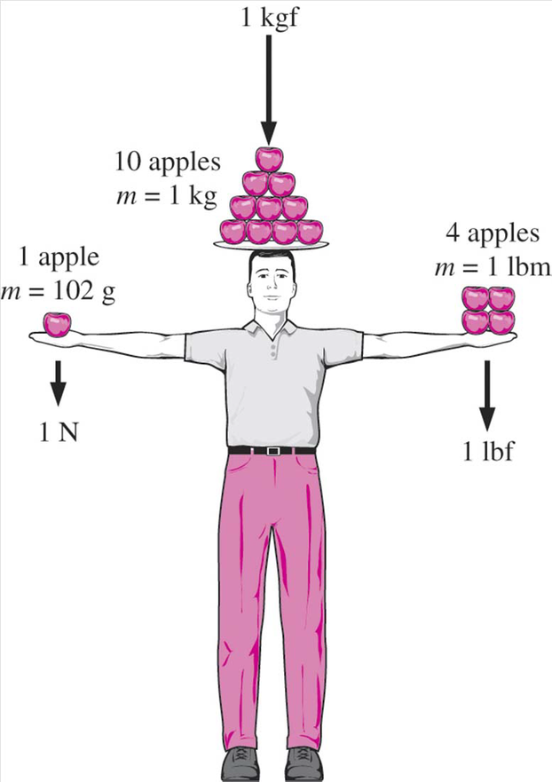

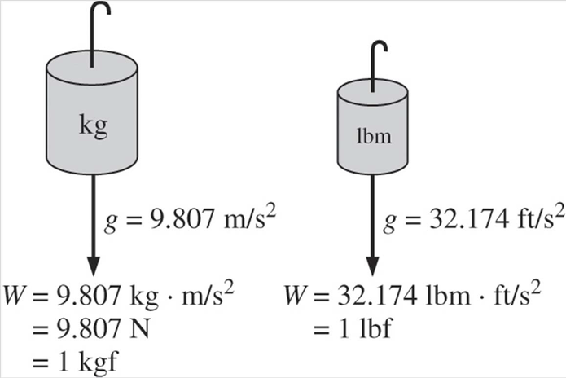
SOME SI AND ENGLISH UNITS
W weight
m mass
g gravitational acceleration
Presented By Gürşah GÜRÜF

Slide 7
THANK YOU
Presented By Gürşah GÜRÜF

