Slide 1




MEE301 - FLUID MECHANICS I
WEEK 1
CHAPTER 1: INTRODUCTION AND BASIC CONCEPTS
Presented By Gürşah GÜRÜF

Slide 2
OBJECTIVES
  Understand the basic concepts of Fluid Mechanics.
  Recognize the various types of fluid flow problems encountered in practice.
  Model engineering problems and solve them in a systematic manner.
  Have a working knowledge of accuracy, precision, and significant digits, and recognize the importance of dimensional homogeneity in engineering calculations.
Presented By Gürşah GÜRÜF

Slide 3
INTRODUCTION
Mechanics: The oldest physical science that deals with both stationary and moving bodies under the influence of forces.
Statics: The branch of mechanics that deals with bodies at rest.
Dynamics: The branch that deals with bodies in motion.
Fluid mechanics: The science that deals with the behavior of fluids at rest (fluid statics) or in motion (fluid dynamics), and the interaction of fluids with solids or other fluids at the boundaries.
Fluid dynamics: Fluid mechanics is also referred to as fluid dynamics by considering fluids at rest as a special case of motion with zero velocity.
Hydrodynamics: The study of the motion of fluids that can be approximated as incompressible (such as liquids, especially water, and gases at low speeds).
Hydraulics: A subcategory of hydrodynamics, which deals with liquid flows in pipes and open channels.
Gas dynamics: Deals with the flow of fluids that undergo significant density changes, such as the flow of gases through nozzles at high speeds.
Aerodynamics: Deals with the flow of gases (especially air) over bodies such as aircraft, rockets, and automobiles at high or low speeds.
Meteorology, oceanography, and hydrology: Deal with naturally occurring flows.
Presented By Gürşah GÜRÜF

Slide 4
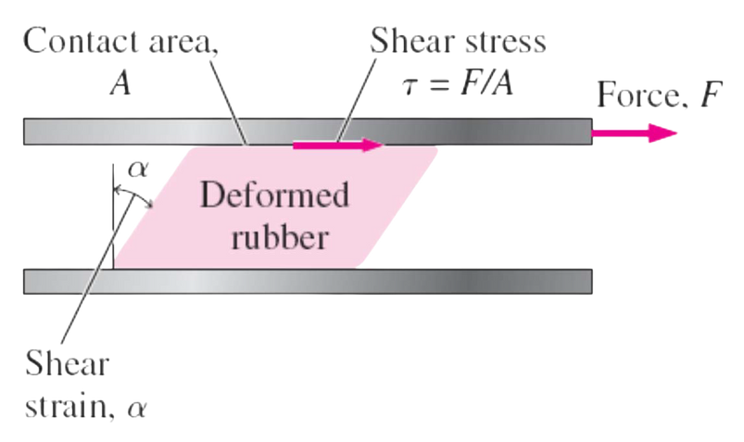
WHAT IS A FLUID?
Fluid: A substance in the liquid or gas phase.
A solid can resist an applied shear stress by deforming.
A fluid deforms continuously under the influence of a shear stress, no matter how small.
In solids, stress is proportional to strain, but in fluids, stress is proportional to strain rate.
When a constant shear force is applied, a solid eventually stops deforming at some fixed strain angle, whereas a fluid never stops deforming and approaches a constant rate of strain.
Deformation of a rubber block placed between two parallel plates under the influence of a shear force. The shear stress shown is that on the rubber—an equal but opposite shear stress acts on the upper plate.
Presented By Gürşah GÜRÜF

Slide 5
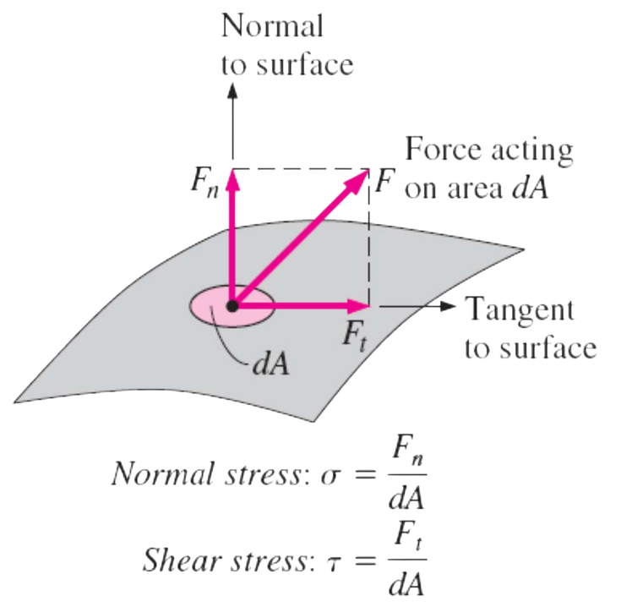
WHAT IS A FLUID?
Stress: Force per unit area.
Normal stress: The normal component of a force acting on a surface per unit area.
Shear stress: The tangential component of a force acting on a surface per unit area.
Pressure: The normal stress in a fluid at rest.
Zero shear stress: A fluid at rest is at a state of zero shear stress.
When the walls are removed or a liquid container is tilted, a shear develops as the liquid moves to re-establish a horizontal free surface.
The normal stress and shear stress at the surface of a fluid element. For fluids at rest, the shear stress is zero and pressure is the only normal stress.
Presented By Gürşah GÜRÜF

Slide 6
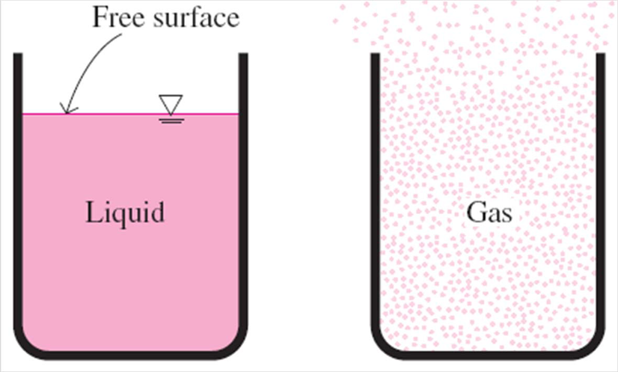
WHAT IS A FLUID?
In a liquid, groups of molecules can move relative to each other, but the volume remains relatively constant because of the strong cohesive forces between the molecules. As a result, a liquid takes the shape of the container it is in, and it forms a free surface in a larger container in a gravitational field.
A gas expands until it encounters the walls of the container and fills the entire available space. This is because the gas molecules are widely spaced, and the cohesive forces between them are very small. Unlike liquids, a gas in an open container cannot form a free surface.
Unlike a liquid, a gas does not form a free surface, and it expands to fill the entire available space.
Presented By Gürşah GÜRÜF

Slide 7
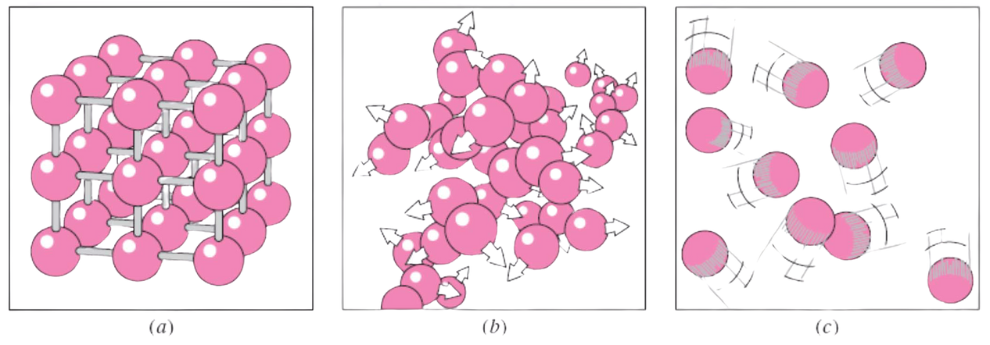
WHAT IS A FLUID?
Intermolecular bonds are strongest in solids and weakest in gases.
Solid: The molecules in a solid are arranged in a pattern that is repeated throughout.
Liquid: In liquids molecules can rotate and translate freely.
Gas: In the gas phase, the molecules are far apart from each other, and molecular ordering is nonexistent.
The arrangement of atoms in different phases: (a) molecules are at relatively fixed positions in a solid, (b) groups of molecules move about each other in the liquid phase, and (c) individual molecules move about at random in the gas phase.
Presented By Gürşah GÜRÜF

Slide 8
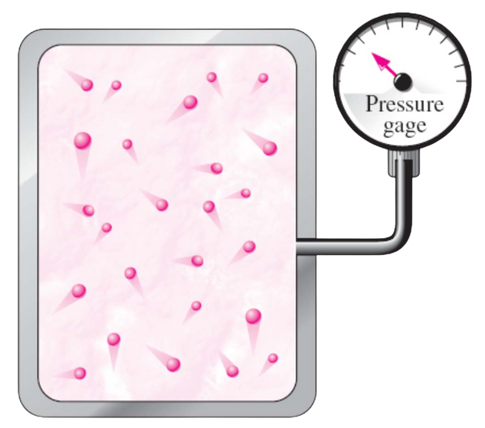
WHAT IS A FLUID?
Gas and vapor are often used as synonymous words.
Gas: The vapor phase of a substance is customarily called a gas when it is above the critical temperature.
Vapor: Usually implies that the current phase is not far from a state of condensation.
Macroscopic or classical approach: Does not require a knowledge of the behavior of individual molecules and provides a direct and easy way to analyze engineering problems.
Microscopic or statistical approach: Based on the average behavior of large groups of individual molecules.
On a microscopic scale, pressure is determined by the interaction of individual gas molecules. However, we can measure the pressure on a macroscopic scale with a pressure gage.
Presented By Gürşah GÜRÜF

Slide 9
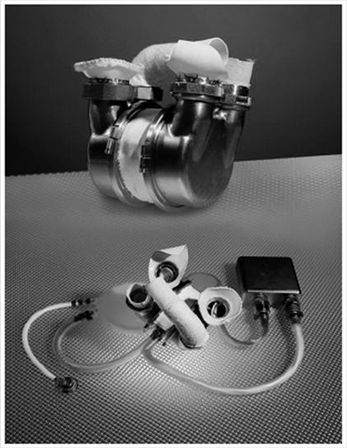





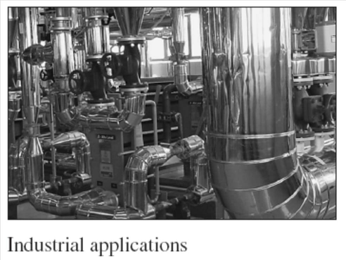
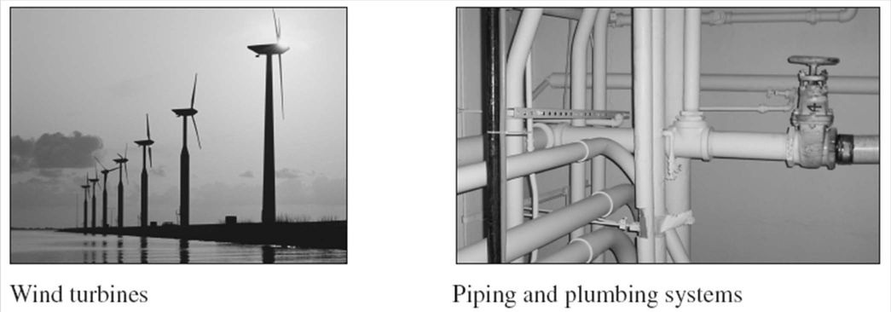
APPLICATION AREAS OF FLUID MECHANICS
Presented By Gürşah GÜRÜF

Slide 10
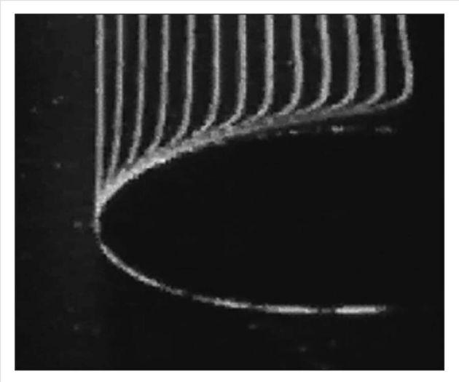
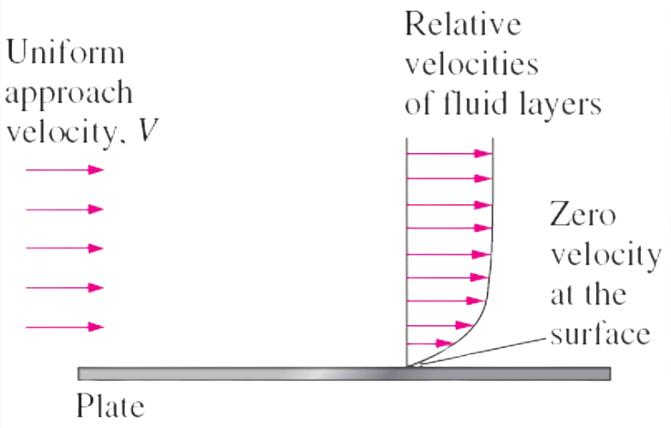
THE NO-SLIP CONDITION
The development of a velocity profile due to the no-slip condition as a fluid flows over a blunt nose.
A fluid flowing over a stationary surface comes to a complete stop at the surface because of the no-slip condition.
Boundary layer: The flow region adjacent to the wall in which the viscous effects (and thus the velocity gradients) are significant.
Presented By Gürşah GÜRÜF

Slide 11
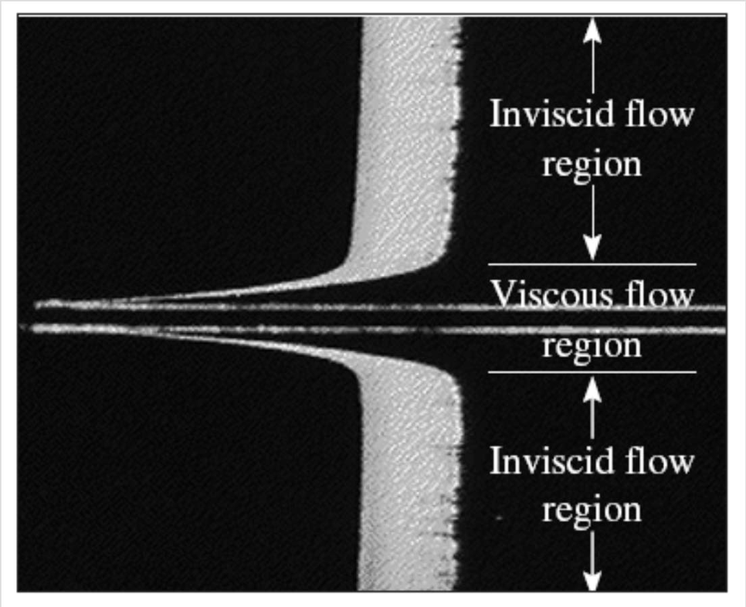
CLASSIFICATION OF FLUID FLOWS
Viscous versus Inviscid Regions of Flow
Viscous flows: Flows in which the frictional effects are significant.
Inviscid flow regions: In many flows of practical interest, there are regions (typically regions not close to solid surfaces) where viscous forces are negligibly small compared to inertial or pressure forces.
The flow of an originally uniform fluid stream over a flat plate, and the regions of viscous flow (next to the plate on both sides) and inviscid flow (away from the plate).
Presented By Gürşah GÜRÜF

Slide 12

CLASSIFICATION OF FLUID FLOWS
Internal versus External Flow
External flow: The flow of an unbounded fluid over a surface such as a plate, a wire, or a pipe.
Internal flow: The flow in a pipe or duct if the fluid is completely bounded by solid surfaces.
Presented By Gürşah GÜRÜF

Slide 13
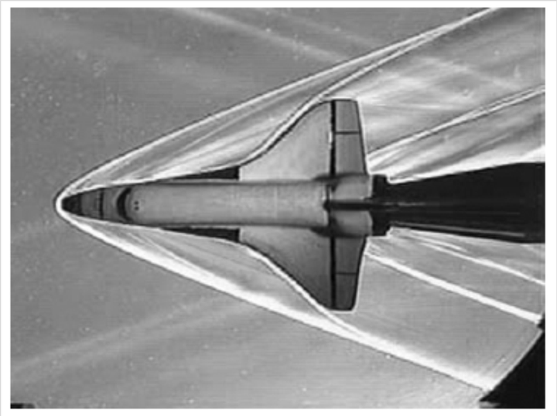
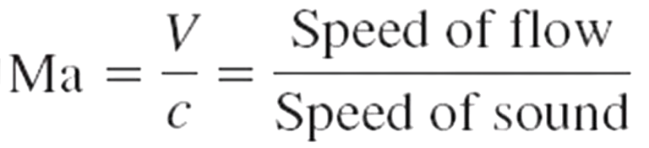
CLASSIFICATION OF FLUID FLOWS
Compressible versus Incompressible Flow
Incompressible flow: If the density of flowing fluid remains nearly constant throughout (e.g., liquid flow).
Compressible flow: If the density of fluid changes during flow (e.g., high-speed gas flow)
When analyzing rockets, spacecraft, and other systems that involve highspeed gas flows, the flow speed is often expressed by Mach number
Ma = 1 Sonic flow
Ma < 1 Subsonic flow
Ma > 1 Supersonic flow
Ma >> 1 Hypersonic flow
Presented By Gürşah GÜRÜF

Slide 14
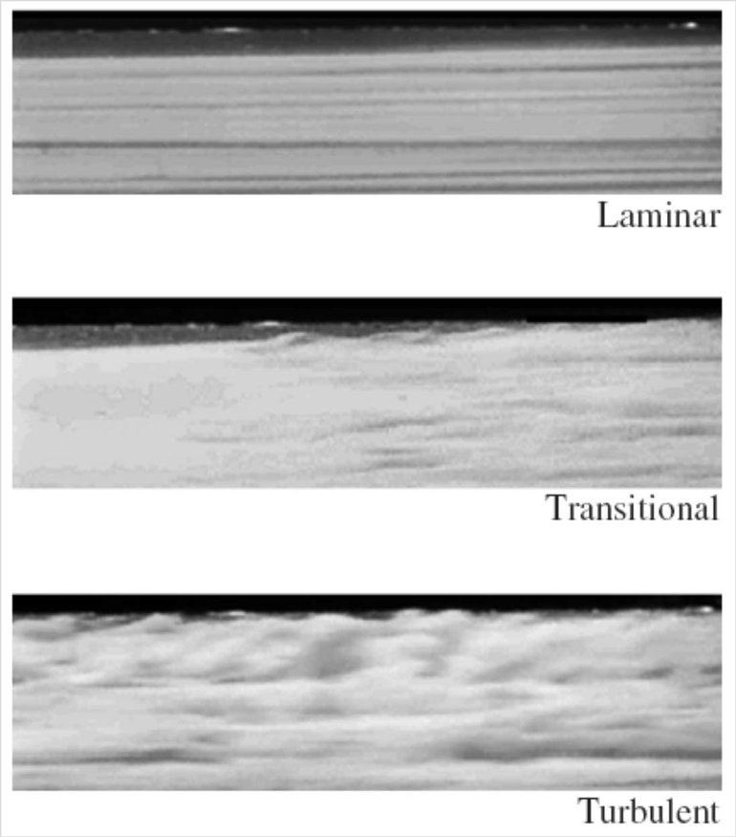
CLASSIFICATION OF FLUID FLOWS
Laminar versus Turbulent Flow
Laminar flow: The highly ordered fluid motion characterized by smooth layers of fluid. The flow of high-viscosity fluids such as oils at low velocities is typically laminar.
Turbulent flow: The highly disordered fluid motion that typically occurs at high velocities and is characterized by velocity fluctuations. The flow of lowviscosity fluids such as air at high velocities is typically turbulent.
Transitional flow: A flow that alternates between being laminar and turbulent.
Presented By Gürşah GÜRÜF

Slide 15
CLASSIFICATION OF FLUID FLOWS
Natural (or Unforced) versus Forced Flow
Forced flow: A fluid is forced to flow over a surface or in a pipe by external means such as a pump or a fan.
Natural flow: Fluid motion is due to natural means such as the buoyancy effect, which manifests itself as the rise of warmer (and thus lighter) fluid and the fall of cooler (and thus denser) fluid.
Presented By Gürşah GÜRÜF

Slide 16
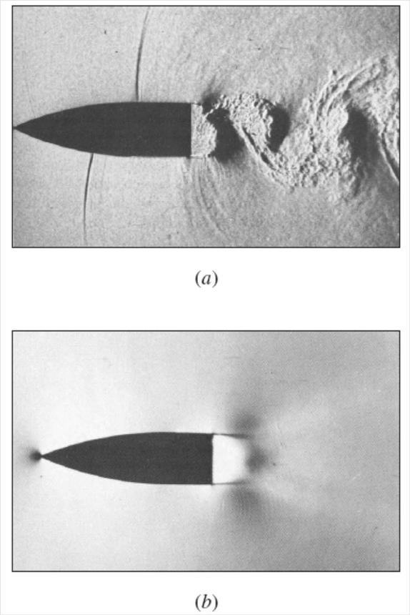
CLASSIFICATION OF FLUID FLOWS
Steady versus Unsteady Flow
The term steady implies no change at a point with time.
• The opposite of steady is unsteady.
• The term uniform implies no change with location over a specified region.
• The term periodic refers to the kind of unsteady flow in which the flow oscillates about a steady mean.
• Many devices such as turbines, compressors, boilers, condensers, and heat exchangers operate for long periods of time under the same conditions, and they are classified as steady-flow devices.
Presented By Gürşah GÜRÜF

Slide 17
THANK YOU
Presented By Gürşah GÜRÜF

